Slide 1
Interfacing Arduino with 16×2 LCD

Slide 2
LCD 16x2 Lab
In this Arduino Lab, we will learn how to connect and use an LCD (Liquid Crystal Display) with Arduino. LCD displays like these are very popular and broadly used in many electronics projects because they are great for displaying simple information, like sensors data, while being very affordable.

Slide 3
What is LCD Character Display?
An LCD character display is a unique type of display that can only output individual ASCII characters with fixed size. Using these individual characters then we can form a text.
If we take a closer look at the display we can notice that there are small rectangular areas composed of 5×8 pixels grid. Each pixel can light up individually, and so we can generate characters within each grid.

Slide 4
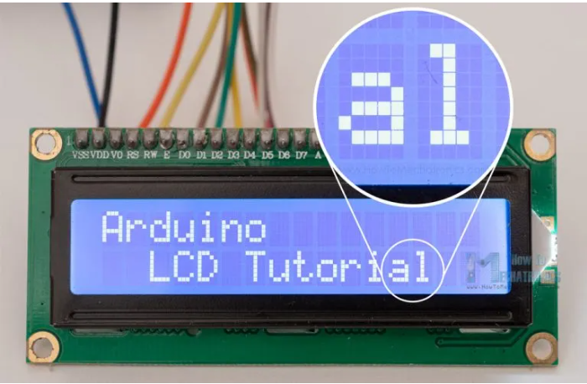
What is LCD Character Display?

Slide 5
What is LCD Character Display?
The number of the rectangular areas define the size of the LCD. The most popular LCD is the 16×2 LCD, which has two rows with 16 rectangular areas or characters. Of course, there are other sizes like 16×1, 16×4, 20×4 and so on, but they all work on the same principle. Also, these LCDs can have different background and text color.

Slide 6
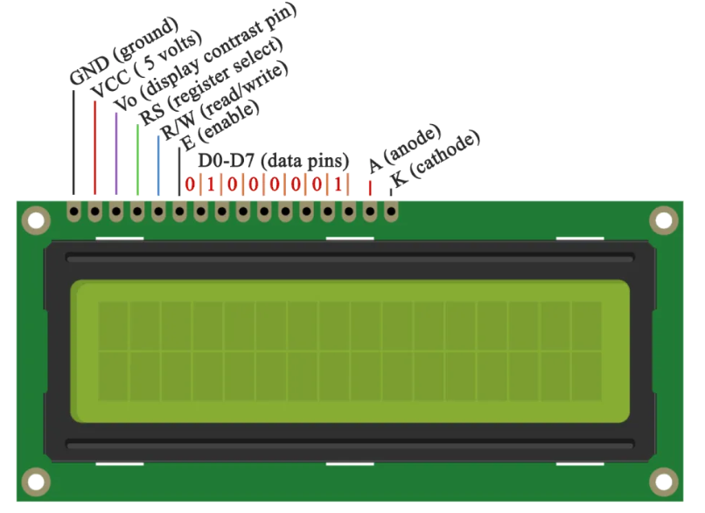
Pin Configuration

Slide 7
Pin Configuration
It has 16 pins and the first one from left to right is the Ground pin. The second pin is the VCC which we connect the 5 volts pin on the Arduino Board. Next is the Vo pin on which we can attach a potentiometer for controlling the contrast of the display.
Next, The RS pin or register select pin is used for selecting whether we will send commands or data to the LCD.
Next comes the R/W pin which selects the mode whether we will read or write to the LCD.
Next is the E pin which enables the writing to the registers, or the next 8 data pins from D0 to D7.

Slide 8
Pin Configuration
After all we don’t have to worry much about how the LCD works, as the Liquid Crystal Library takes care for almost everything. From the Arduino’s official website you can find and see the functions of the library which enable easy use of the LCD. We can use the Library in 4 or 8 bit mode. In this tutorial we will use it in 4 bit mode, or we will just use 4 of the 8 data pins.

Slide 9
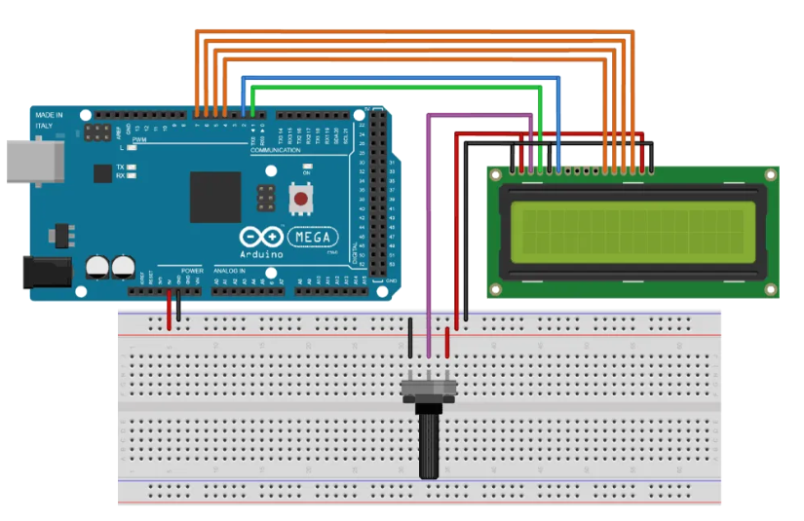
How to Connect Arduino to LCD – Wiring Diagram

Slide 10
How to Connect Arduino to LCD – Wiring Diagram
We will use just 6 digital input pins from the Arduino Board. The LCD’s registers from D4 to D7 will be connected to Arduino’s digital pins from 4 to 7. The Enable pin will be connected to pin number 2 and the RS pin will be connected to pin number 1. The R/W pin will be connected to Ground and the Vo pin will be connected to the potentiometer middle pin.

Slide 11
How to Connect Arduino to LCD – Wiring Diagram
Components required:
16x2 Character LCD
Potentiometer
Arduino Board
Breadboard and Jump Wires

Slide 12
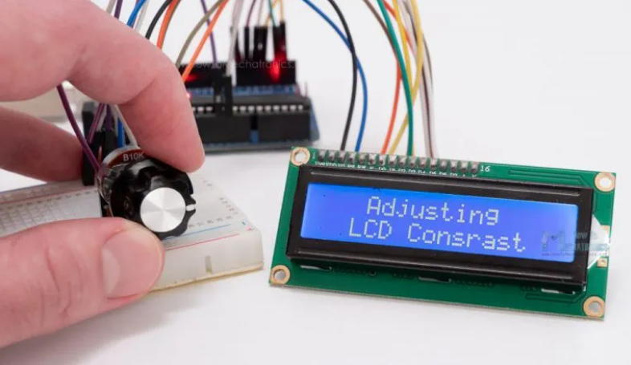
Adjusting the contrast of the LCD
We can adjust the contrast of the LCD by adjusting the voltage input at the Vo pin. We are using a potentiometer because in that way we can easily fine tune the contrast, by adjusting input voltage from 0 to 5V.

Slide 13
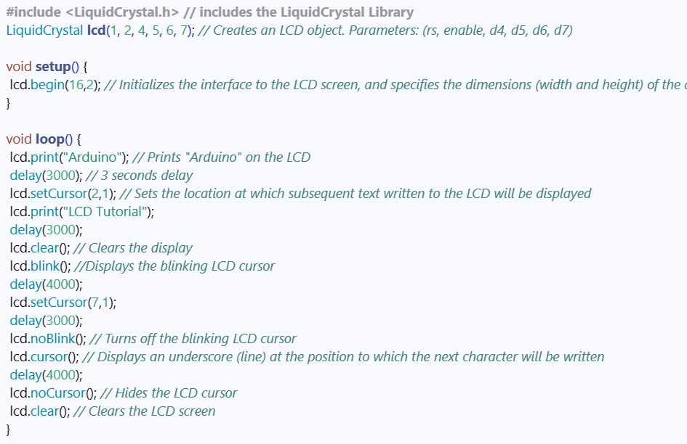
LCD Arduino Code

Slide 14
Code Explanation
First thing we need to do is it insert the Liquid Crystal Library. We can do that like this: Sketch > Include Library > Liquid Crystal. Then we have to create an LC object. The parameters of this object should be the numbers of the Digital Input pins of the Arduino Board respectively to the LCD’s pins as follow: (RS, Enable, D4, D5, D6, D7). In the setup we have to initialize the interface to the LCD and specify the dimensions of the display using the begin() function.
In the loop we write our main program. Using the print() function we print on the LCD.

Slide 15
Code Explanation
The setCursor() function is used for setting the location at which subsequent text written to the LCD will be displayed.
The blink() function is used for displaying a blinking cursor and the noBlink() function for turning off.
The cursor() function is used for displaying underscore cursor and the noCursor() function for turning off. Using the clear() function we can clear the LCD screen.

Slide 16
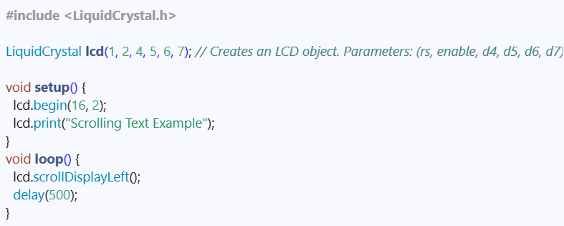
Additional Functions for Text Display
Scrolling text example on 16×2 LCD and Arduino
In case we have a text with length greater than 16 characters, we can scroll the text using the scrollDisplayLeft() or scrollDisplayRight() function from the LiquidCrystal library.

Slide 17
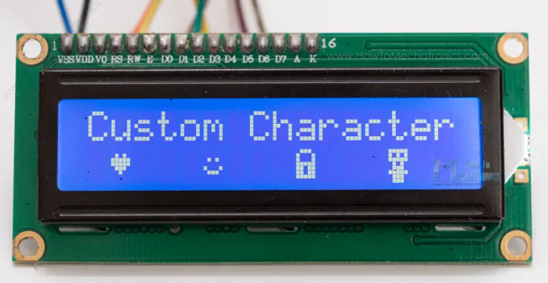
Generate and Display Custom Characters on the LCD
In addition to the ASCII characters, with the LiquidCrystal library it is also possible to generate and display custom characters on the LCD.

Slide 18
Generate and Display Custom Characters on the LCD
We can specify the appearance of each character by an array of 8 bytes. Here’s an example code:
#include <LiquidCrystal.h>
byte smile[8] = { B00000,
B00000,
B01010,
B00000,
B10001,
B01110,
B00000,
B00000 };

Slide 19
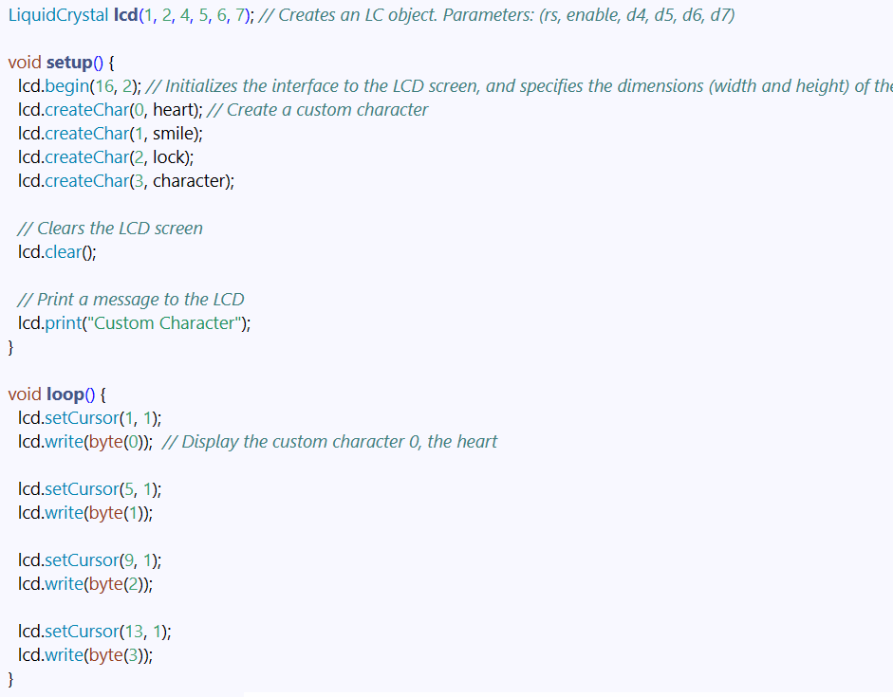
Generate and Display Custom Characters on the LCD

Slide 20
Generate and Display Custom Characters on the LCD
In the setup we have to create the custom character using the createChar() function.
The first parameter in this function is a number between 0 and 7, or we have to reserve one of the 8 supported custom characters. The second parameter is the name of the array of bytes.
We write the custom character to the display using the write() function and as a parameter we use the number of the character.

Slide 21
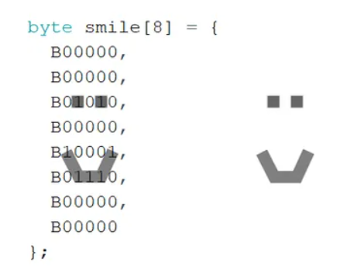
Generate and Display Custom Characters on the LCD
We can notice how we can specify the appearance of the character by changing the 0s into 1s within the 5×8 pixels grid.

Slide 22
Conclusion
We have reviewed all the necessary information for utilizing an LCD with Arduino. These character displays are useful for displaying information in various electronics projects. The examples provided used a 16x2 LCD, but the same concepts apply to other sizes of character displays as well.

Slide 23
Q&As

